Slide 1
ENHANCING ERGONOMICS - POSTURE ALERT SYSTEM
Team Members:
1. MUKUNTHAN S
2. NAVEEN KUMAR E
3. SANTHOSH S
Guided By:
Mr.M.SARAVANAN

Slide 2
Content
1. Objective
2. Problem Statement
3. Existing System
4. Proposed System
5. Architecture
6. Literature Survey
7.Modules in Project
8.Sample Output
9.Future Enhancements
10.References

Slide 3
Objective
The objective of the project is to develop a system that leverages machine learning techniques to detect and alert individuals about poor posture while they are using mobile devices or laptops. The primary goal is to improve workplace ergonomics and prevent musculoskeletal disorders caused by prolonged incorrect posture.

Slide 4
Problem Statement
Prolonged incorrect posture while working on mobile devices or laptops can lead to various health issues such as neck pain, back pain, and repetitive strain injuries.
Many individuals are unaware of their poor posture habits and need timely reminders to correct them.
Existing solutions for posture correction are often manual and lack real-time feedback, making them less effective.

Slide 5
Existing System
Manual methods such as ergonomic assessments and periodic reminders lack real-time monitoring and feedback, making them less effective in correcting posture habits. Some mobile applications offer posture tracking features, but they may not be accurate or reliable. Wearable devices like posture correctors exist but may be uncomfortable or inconvenient for long-term use.

Slide 6
Proposed System
To Develop a machine learning model to accurately detect and analyze posture using the camera on mobile and laptop devices.
Integrate the model that provides real-time feedback and alerts users when they adopt poor posture.
Utilize data analytics to track users' posture habits over time and provide personalized recommendations for improvement.

Slide 7
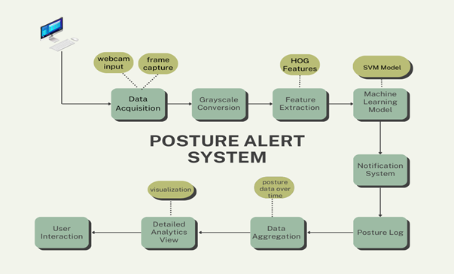
Architecture

Slide 8
Literature Survey
Title | Advantages | Disadvantages
A RTSC (Real Time & Self Calibrating) Algorithm Based on Tri-axial Accelerometer Signals for the Detection of Human Posture and Activity" by Curone et al., 2010 | Real-time, Self-calibrating, Adaptive | Accelerometer-only, Computational complexity
Bearing Defect Detection Using Onboard Accelerometer Measurements" by Donelson and Dicus, 2002 | Predictive maintenance, Reduce downtime | Specific to bearings, Tailoring required

Slide 9
Literature Survey
Title | Advantages | Disadvantages
"Clinical Applications of Sensors for Human Posture and Movement Analysis: A Review" by Wong et al., 2007 | Comprehensive review, Clinical applications | Not a specific solution, Potentially outdated
Design of an Inline Accelerometer-Based Inclination Sensing System" by Yao et al., 2012 | Inclination sensing, Practical considerations | Limited to inclination, Custom hardware

Slide 10
Literature Survey
Title | Advantages | Disadvantages
"Forward Flexed Posture Detection for the Early Parkinson's Disease Symptom" by Wu et al., 2014 | Early disease detection, Healthcare applications | Specific to forward flexion, Parkinson's context
"Light Weight Online Unsupervised Posture Detection by Smartphone Accelerometer" by Yürür et al., 2015 | Unsupervised, Leverages existing hardware | Requires smartphone, Hardware limitations

Slide 11
Modules
Data Acquisition and Preprocessing
Feature Extraction
Posture Classification
Alert Generation
Data logging and Analytics
User Interface

Slide 12
Data Acquisition And Preprocessing Module
This module is responsible for capturing realtime video data from the user's webcam. It continuously streams the video feed, ensuring that the system has up to date visual information to analyze the user's posture. The raw video data undergoes several enhancements to improve quality and reduce noise, making it suitable for analysis.
Key preprocessing steps include:
1.Image Resizing
2.Grayscale Conversion
3.Noise Reduction

Slide 13
Feature Extraction Module
This module is dedicated to extracting relevant features from the preprocessed images, which represent the user's posture. By utilizing advanced techniques such as Histogram of Oriented Gradients (HOG), the module captures critical spatial information and shape descriptors.
The process involves:
HOG Feature Extraction

Slide 14
Posture Classification Module
This module employs machine learning algorithms to classify the user's posture as "good" or "bad" based on the extracted features.
The steps involved include:
Model Training
Real time Prediction
Algorithm Optimization

Slide 15
Alert Generation Module
This module is responsible for generating alerts when poor posture is detected. It
provides multiple customizable notification methods to prompt users to adjust their
Posture.
The module ensures that the notifications are timely and effective in encouraging users to
correct their posture immediately.
Visual Alerts: Displaying onscreen notifications or changing the color of the interface to
indicate bad posture.

Slide 16
Data Logging And Analytics Module Data Logging
This component logs the posture data over time, maintaining a comprehensive database of historical posture records. The analytics component performs in depth analysis on the logged data to generate insights and reports.
Ergonomic Scores
Visualization

Slide 17
User Interface Module
This module provides an intuitive and engaging dashboard for users to interact with the system.
Key features include:
1) Real-time Alerts
2) Personalized Analytics
3) Customizable Settings

Slide 18
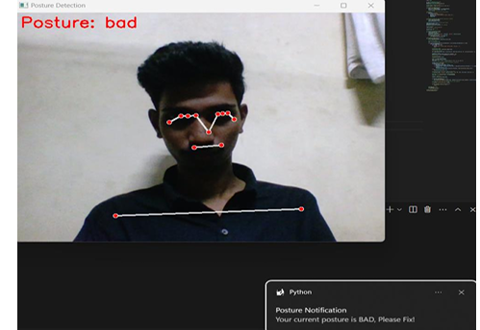
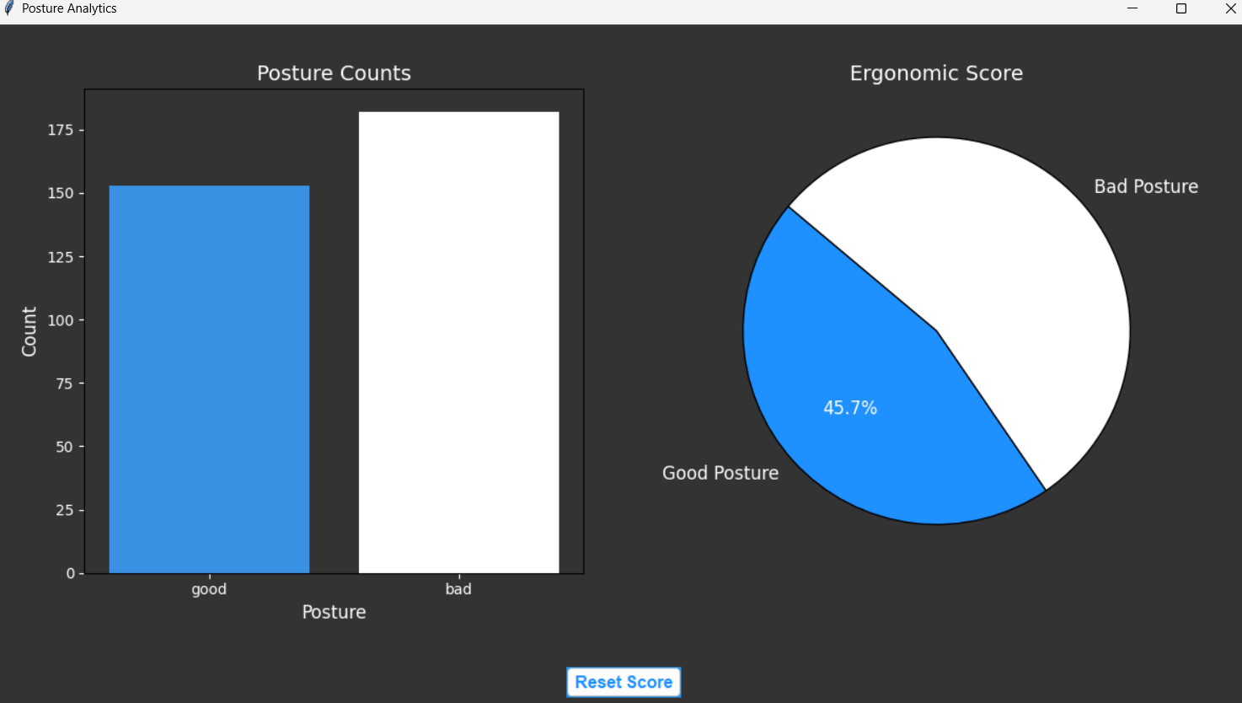
Sample Output

Slide 19
Future Enhancements
Integration with Virtual Reality (VR) and Augmented Reality (AR):
Utilizing VR and AR technologies to provide interactive and immersive posture correction sessions, which can be particularly useful for rehabilitation purposes.
Remote Monitoring and Reporting:
Enabling remote monitoring features for caregivers or employers to track the posture health of individuals, which can be useful in workplaces or for elderly care.
Integration with Office Tools:
Embedding the posture alert system into commonly used office software like Microsoft Teams, Slack, or Zoom to provide seamless posture monitoring during meetings and work sessions.
AI-Driven Virtual Health Coach:
Personalized Guidance: Implementing an AI-driven virtual health coach that interacts with users, providing personalized posture advice, health tips, and motivational support.
Gamification: Adding gamification elements to encourage regular use and engagement with the posture alert system.

Slide 20
References
[1] "Machine Learning Algorithms Application For The Proposed Sitting Posture Monitoring System" Ferdews Tlili, Rim Haddad, Ridha Bouallegue, Raed Shubair, 2022. https://doi.org/10.1016/j.procs.2022.07.031
[2] "A Smart System for Sitting Posture Detection Based on Force Sensors and Mobile Application" Slavomir Matuska, Martin Paralic, Robert Hudec, 2020. https://doi.org/10.1155/2020/6625797
[3] "A portable sitting posture monitoring system based on a pressure sensor array and machine learning" Xu Ran, Cong Wang, Yao Xiao, Xuliang Gao, Zhiyuan Zhu, Bin Chen, 2021. https://doi.org/10.1016/j.sna.2020.112574
[4] "A Proposal of Implementation of Sitting Posture Monitoring System for Wheelchair Utilizing Machine Learning Methods" Jawad Ahmad, Johan Sidén, Henrik Andersson, 2021. https://doi.org/10.3390/s21113824
[5] "A Deep-Learning Based Posture Detection System for Preventing Telework Related Musculoskeletal Disorders" Enrique Piñero-Fuentes, Salvador Canas-Moreno, Antonio Rios-Navarro, Manuel Domínguez-Morales, José Luis Sevillano, Alejandro Linares-Barranco, 2021.https://doi.org/10.3390/s21092998

Slide 21
Thank You

